Slide 1
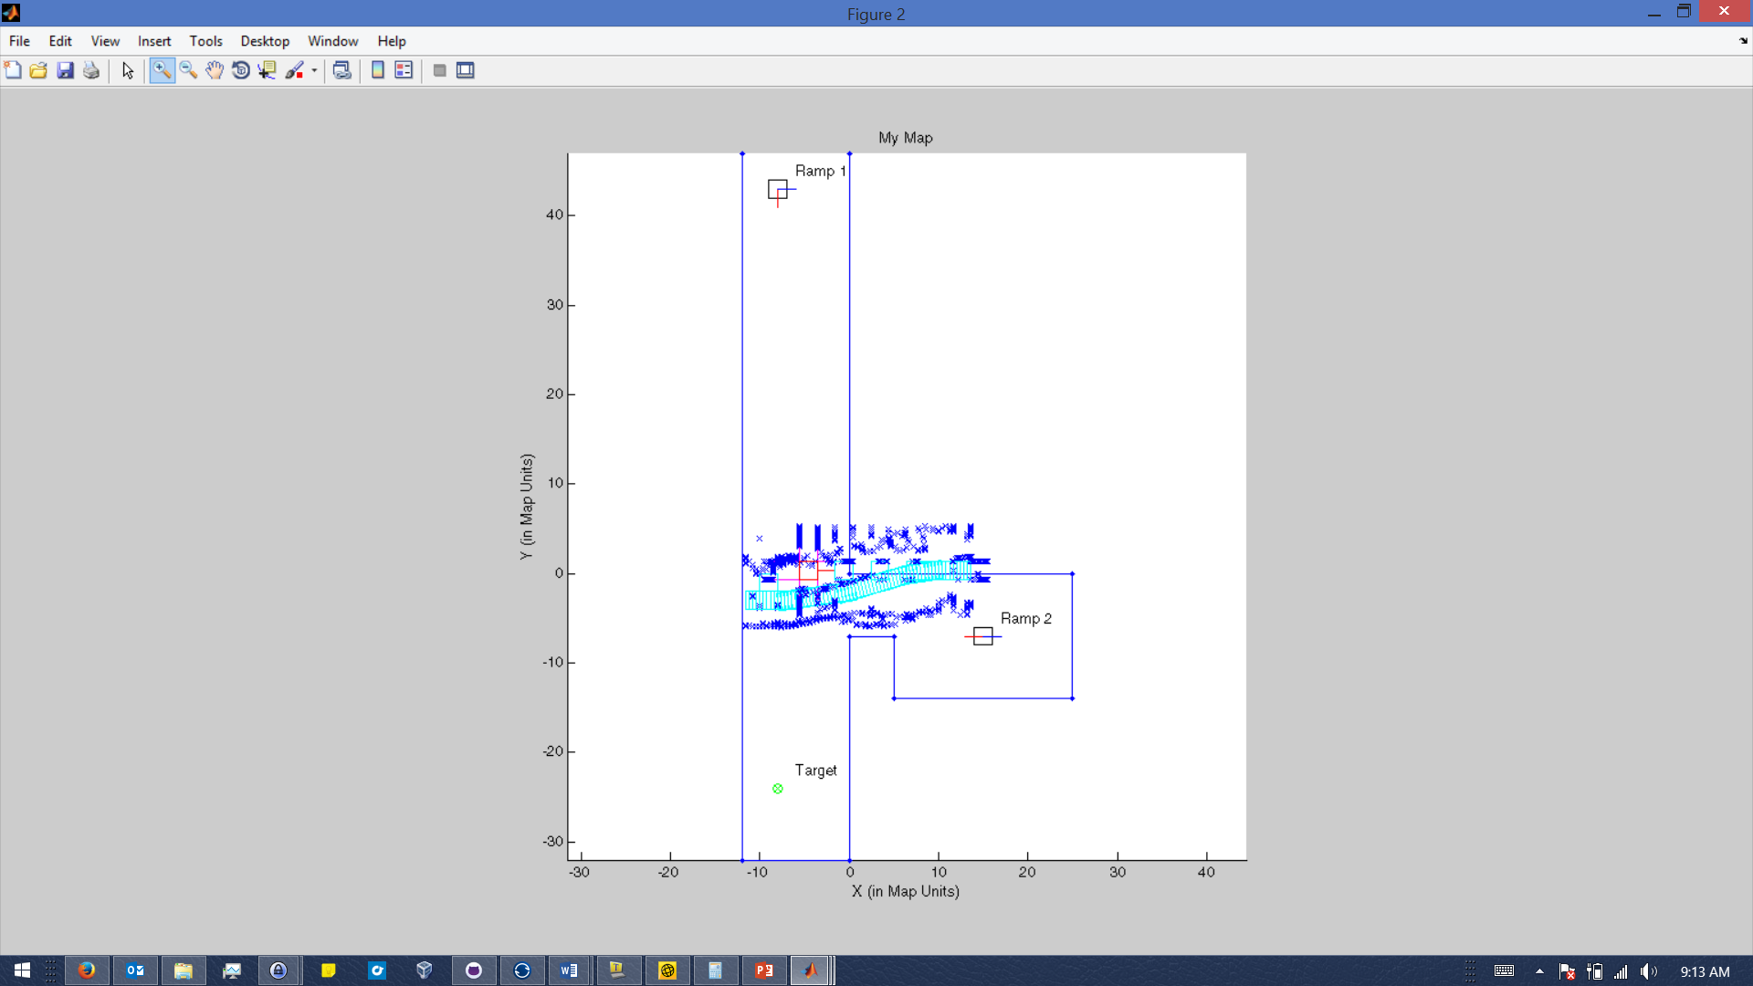
Simulation
ARM Simulation
Manual motor commands
Wall detection
Mapping position and sensor data in real time
Sensor Simulation
Simulated sensor data points for every sensor
Robust communication defaulting
Real ARM/Rover passthrough
Simulation acts as a passthrough for communication between the ARM board and the rover, able to map the rovers movement and sensor data while being controlled by the ARM.
Rover
Past Rover Path
Wall
Wall detection

